Slide 1
Formula 1 Data Analysis
By:
Archit Hallan
Chisom Ozoemena
Ismail Omer
Yargi Kilinc

Slide 2
Mission Statement
Mission Statement: Why do the top 3 winning team win within the last 20 years and what factors help the winning team reach the podium.
Main Audience: Team Coach
What factors contribute into winning a F1 championship? The question would be answered after looking at the following 4 factors closely:
The type of Constructor (car)
The age of the driver
Role of pit stops
The fastest lap speed.

Slide 3
Type of Constructor
Determine the top 3 constructors over the last 20 years based on number of wins
Determine the top constructors based on nationality

Slide 4
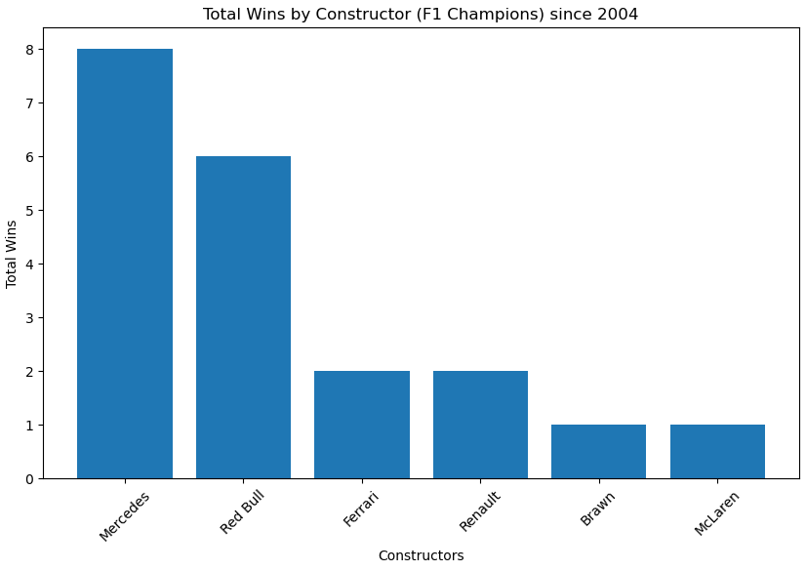

Slide 5
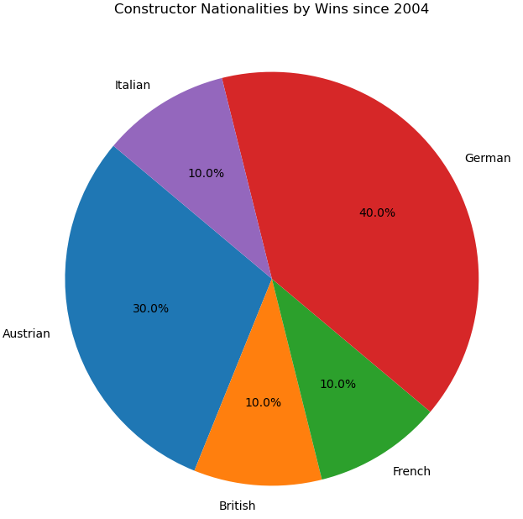
Based on the data, the top 3 most successful constructors in the last 20 years are Mercedes, and Ferrari/Renault. Mercedes has the most amount of championships during that time. There can be many reasons for a successful type of car: such as investment of resources, technical innovation and manufacturing. My analysis of F1 championships is restricted by the data available, which only focuses on the type of car as a factor.

Slide 6
Age of driver
Does age really matter?

Slide 7
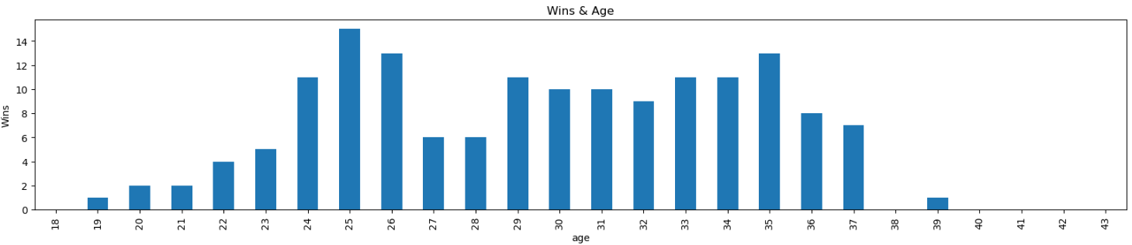
Why would Age matter
Age might matter due to the following reasons:
1.Experience and Skill Development: Younger drivers might lack the experience and skill development that is formed after several years of competitive racing
2.Physical Fitness: Motorsports demand a high level of physical fitness and stamina. Younger drivers may have a natural advantage in terms of physical fitness and reaction time, which can be crucial in competitive racing. There are more other reasons as to why age might be worth looking into.
Looking at the graph below, it is evident that most drivers that are 20s have the highest wins(15), and a close second would be drivers 30s.. Does this mean that younger drivers are better?

Slide 8

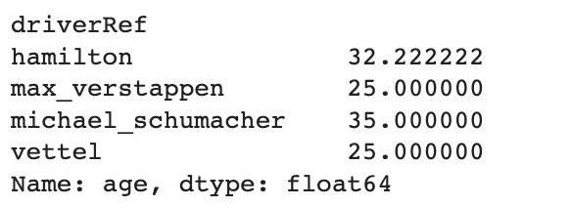
A correlation test was performed and it showed that were a minor positive correlation between the winnings and the age of the driver. The correlation showed a 0.06 correlation between those two factors. Also looking at the top 4 drivers with the most wins, two of them were in the 20s and the other two were in their 30s, which matched the bar chart that showed drivers in the 20s(25,26) and in their 30s(35) do have a high chance of getting more wins, there is a correlation but not enough to make a direct fact that age has enough impact of winning a F1 championship

Slide 9
The Pivotal Role of F1 Pit Stops
When we think of F1, we imagine speed and precision on the track. But the real game-changer? The few seconds spent in the pit lane. That's our focus today.
Significance: In the high-speed world of Formula 1, every second counts. Pit stops, a seemingly brief interlude, often play a pivotal role in race outcomes.
Objective: Through rigorous data analysis, we seek to understand just how much weight pit stops carry in the grand scheme of race strategies and eventual outcomes.
Scope: Dive deep into visual representations that cast light on pit stop durations versus race results and the varied strategies of constructors.

Slide 10
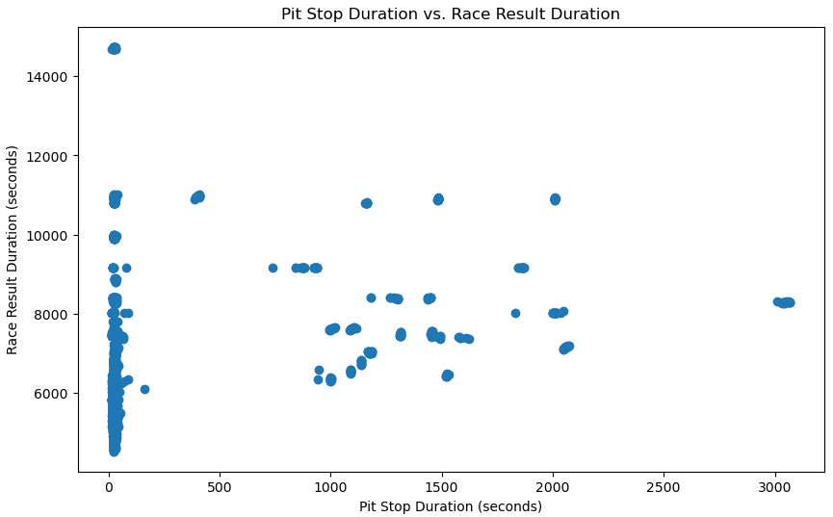
Does Time in the Pits Reflect on the Track?
Analysis: The scatter plot displays an intricate relationship. A correlation of 0.03, while subtle, underscores that efficient pit stops might lean towards improved race outcomes. However, the presence of outliers highlights the multifaceted nature of race performance.
Insight: While a speedy pit stop can be a strategic advantage, it's clear that other race elements also strongly influence outcomes.
Pit Stop Duration vs. Race Result Duration

Slide 11
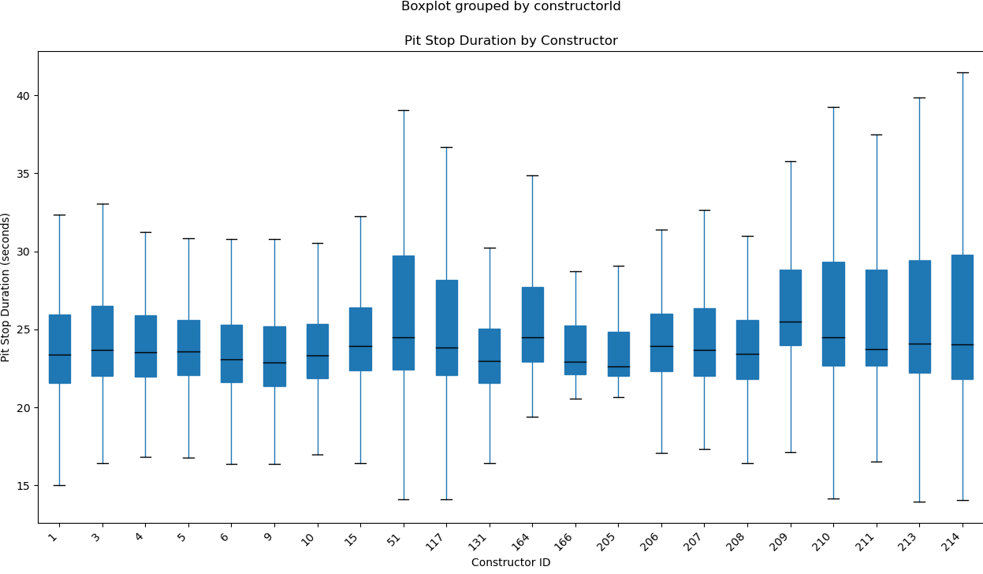
Analysis: Pit stop durations vary significantly among constructors. Some teams consistently maintain similar durations, while others exhibit substantial variation, hinting at diverse strategies or performance fluctuations.
Box Plot & ANOVA Insights: A box plot visually confirms these differences, while ANOVA analysis with a p-value of 3.74e-23 solidifies the argument: pit stops are about choices, preparation, and risk-taking.
Conclusion: Pit stops in Formula 1 are not just about raw speed; they represent a narrative of teams' strategic choices, preparation, and calculated risks. This strategic diversity adds intrigue to the sport.
Constructor Strategies: Pit Stop Duration Variance

Slide 12
Lap Speed
Determine the top 10 teams with highest lap speeds in the past 20 years of Formula 1 history.
Determine if obtaining the highest lap speed in a race results with being on the podium as one of the 3 finalist.

Slide 13
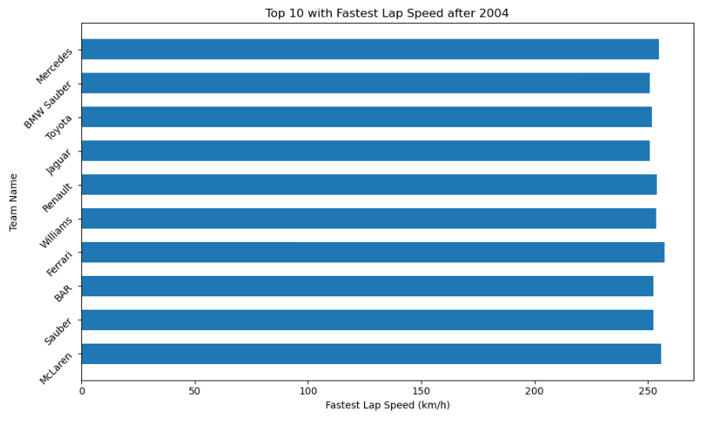
Based on the data, the team who reached the highest lap speeds in the past 20 years are Ferrari with speeds of 257.320 & 256.324 km/h during ‘race 104’ and McLaren with a speed of 255.874 km/h during ‘race 85’ in 2005.

Slide 14
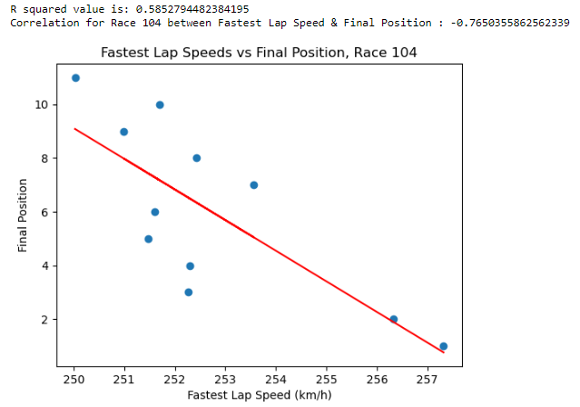
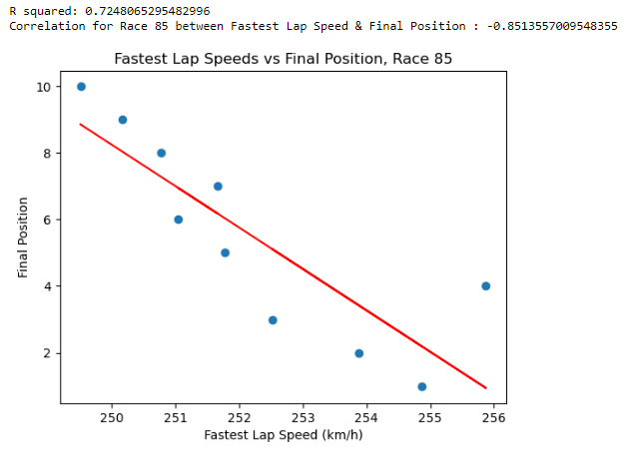
There can be many reasons and factors to win a race in Formula 1.
Looking into races with record highest lap speeds in the past 20 years and the negative correlation with the final positions, it is possible to say that reaching the highest speeds in a lap likely results with a place in the podium as a finalist in first 3.

Slide 15
Conclusion
Key Factors Determining F1 Championship Success
Contractors (Car): Mercedes dominates recent history. The overall car design, aerodynamics, and performance are paramount.
Driver's Age: While age plays a role, it's not the decisive factor in championship wins.
Pit Stops: Efficiency matters. Teams that optimize pit stops can significantly boost their race position, influencing championship outcomes.
Fastest Lap Speed: Ferrari and McLaren lead in top speeds. Reaching the highest speed in a lap often correlates with podium finishes.
Conclusion: Winning an F1 championship is a symphony of optimized car performance, driver skill, strategic pit stops, and pushing speed limits. Every detail counts in this pinnacle of motorsport.

